Slide 1



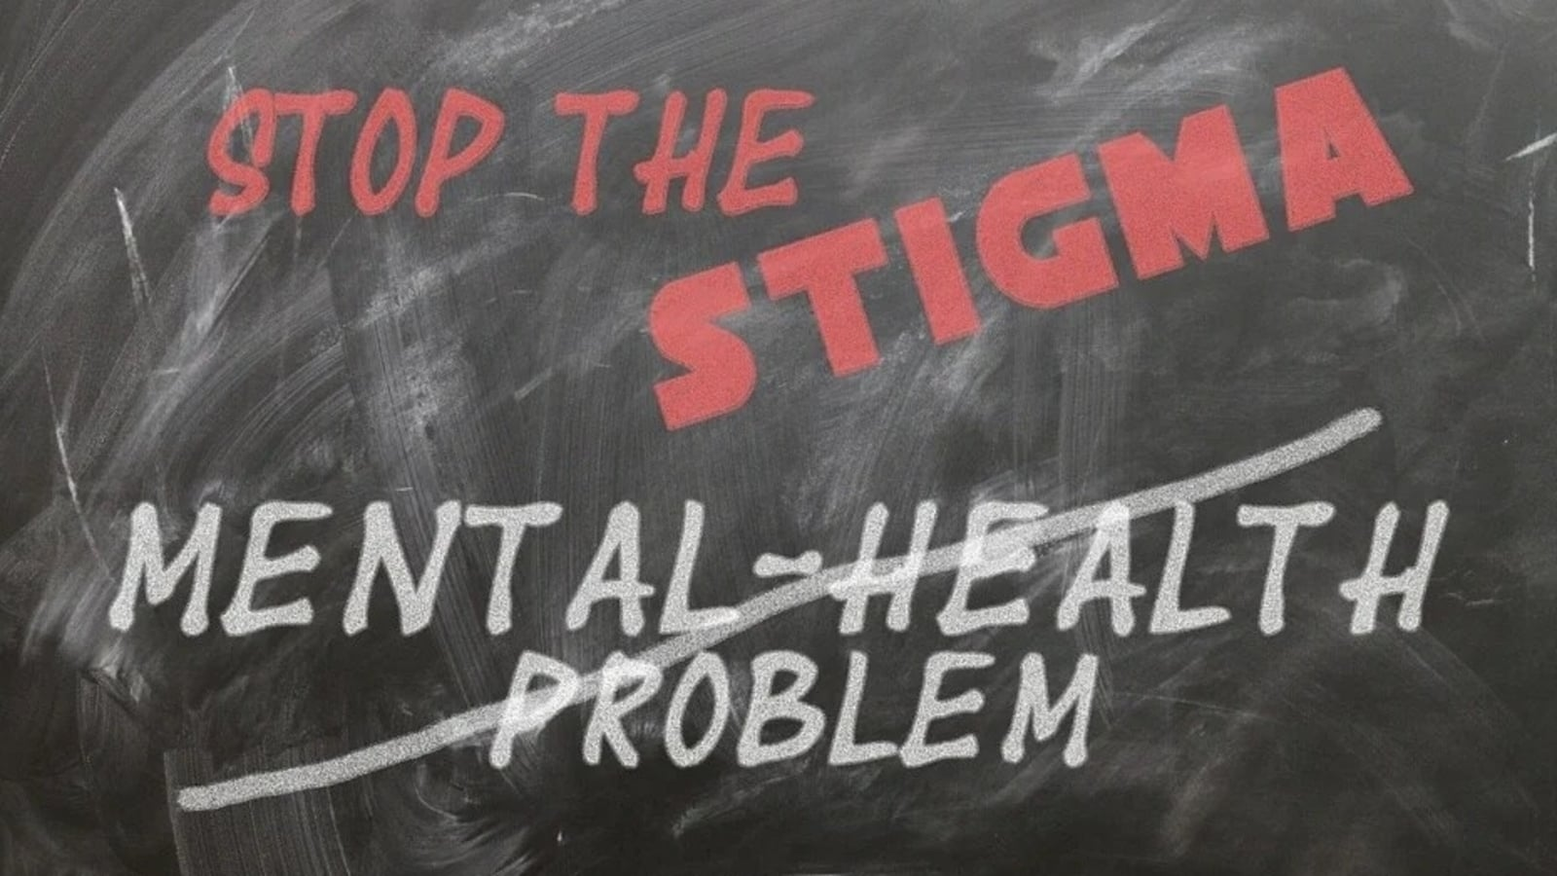
Employee Mental Health Prediction
Centre for Development of Advanced Computing DBDA Noida Batch March 2022
Project By :-
Pratik Deshmukh.
Sonali Sharma.
Ankit Hiwarkar.
Shiv Dabhade.

Slide 2

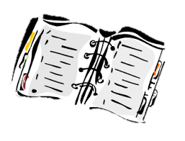
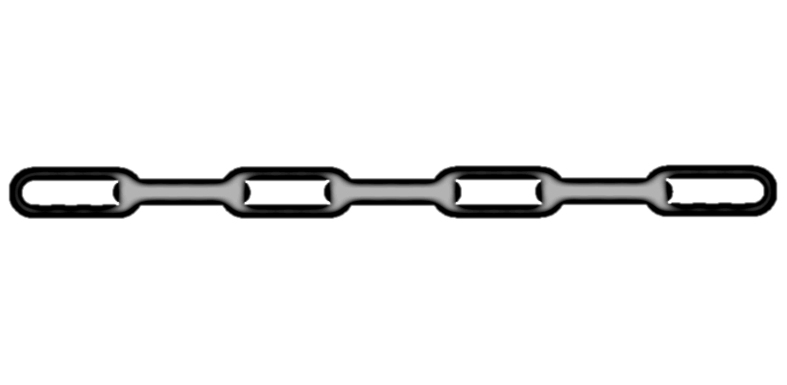
Introduction
Problem Statement and Objectives
Methodology.
Data Collections and Pre-Processing.
Data Handling.
Machine Learning Algorithms.
Data Visualization.
Power BI Dashboard.
Conclusion and Future Scope
References

Slide 3
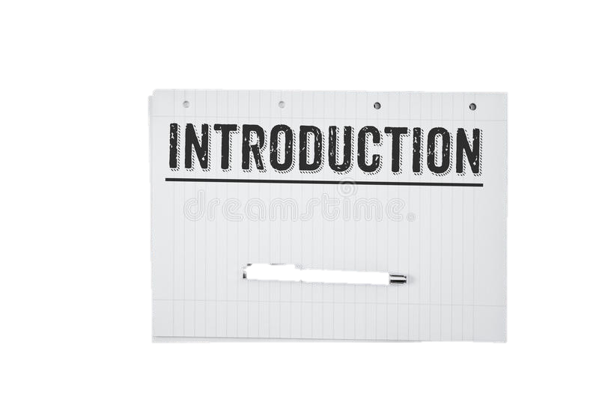
Mental illness is a health problem that undoubtedly impacts emotions, reasoning, and social interaction of a person. These issues have shown that mental illness gives serious consequences across societies and demands new strategies for prevention and intervention.
Stress
Fear
Anxiety
Depression

Slide 4
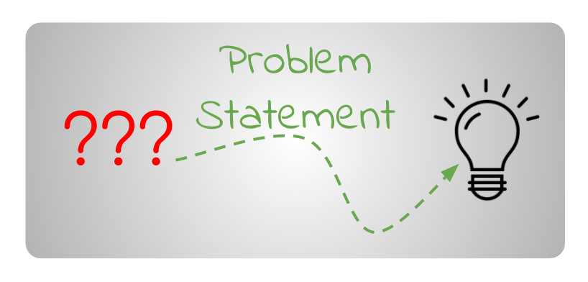
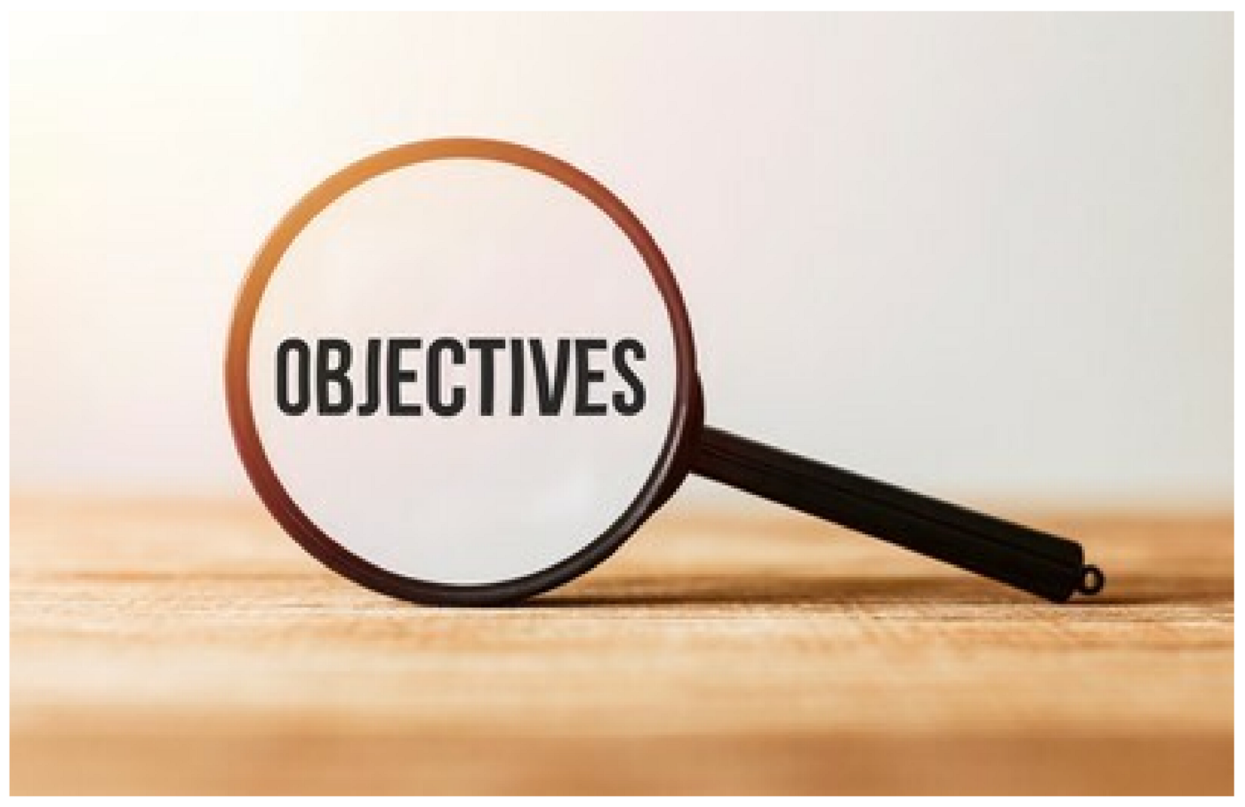
To Examines the frequency of mental health disorders among employees and analysis their frame of mind towards mental health in the workplaces.
To Raise awareness about the importance of mental health and well-being.
To provide and promote access to evidence based, high quality mental health care.
To manage psychosocial risks related to work, environment and culture.

Slide 5


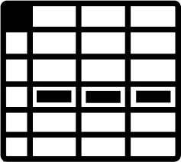
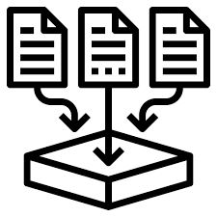
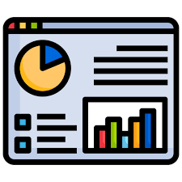

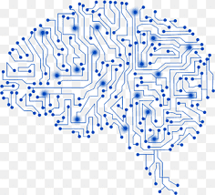
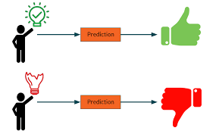
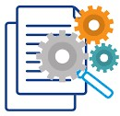
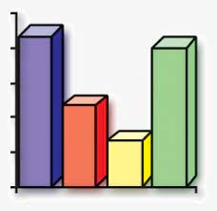
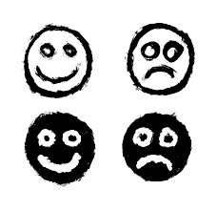
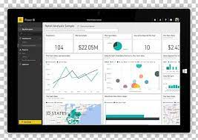
Data Cleaning
Raw Data
Data Pre-processing
Data Collection
Exploratory data Analysis
Machine Learning Algorithm
Comparing result
Prediction
Conclusion
Data Handling
Dashboard

Slide 6

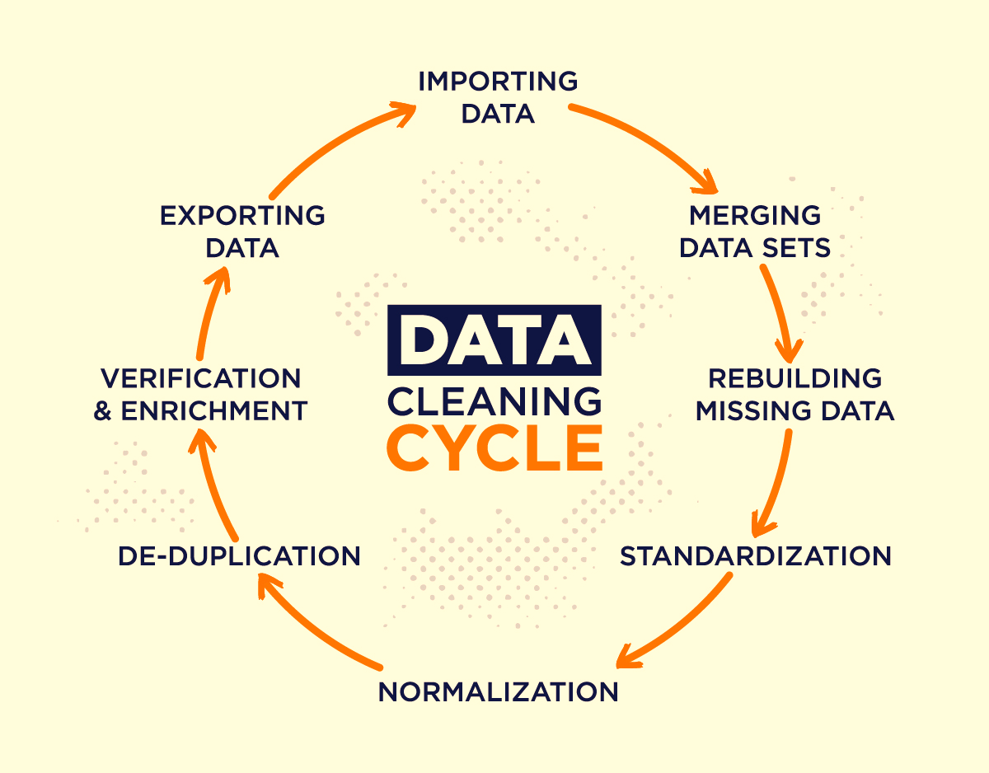
Data Collection and Pre-Processing
The process of gathering and analyzing accurate data from various sources to find answers to research problems, trends and probabilities, etc., to evaluate possible outcomes is Known as Data Collection
The dataset we are using is from the Mental Health in Tech Survey. They have been doing this survey each year since then but we found the data from 2014-2021 best for our Project.
Data Pre-processing a component of data preparation describes any type of processing performed on raw data to prepare it for another data processing procedure. It has traditionally been an important preliminary step for the data mining process. Mostly recently data pre-processing techniques have been adapted for training machine learning modes and AI models and for running inferences against them

Slide 7
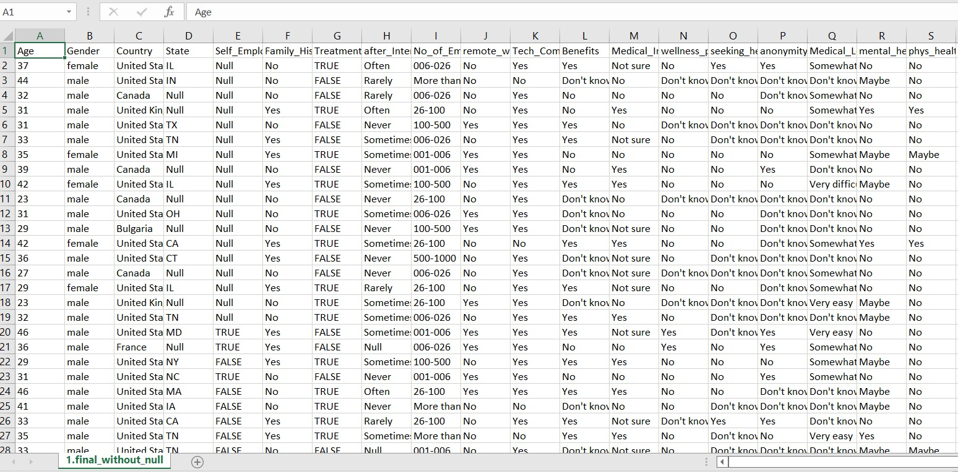
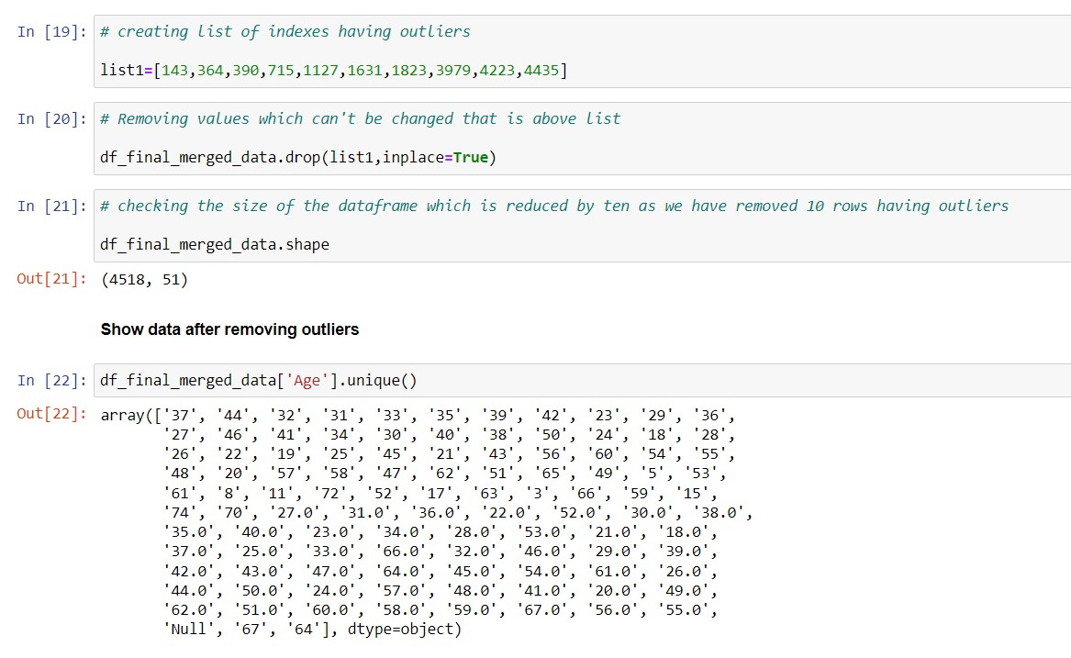
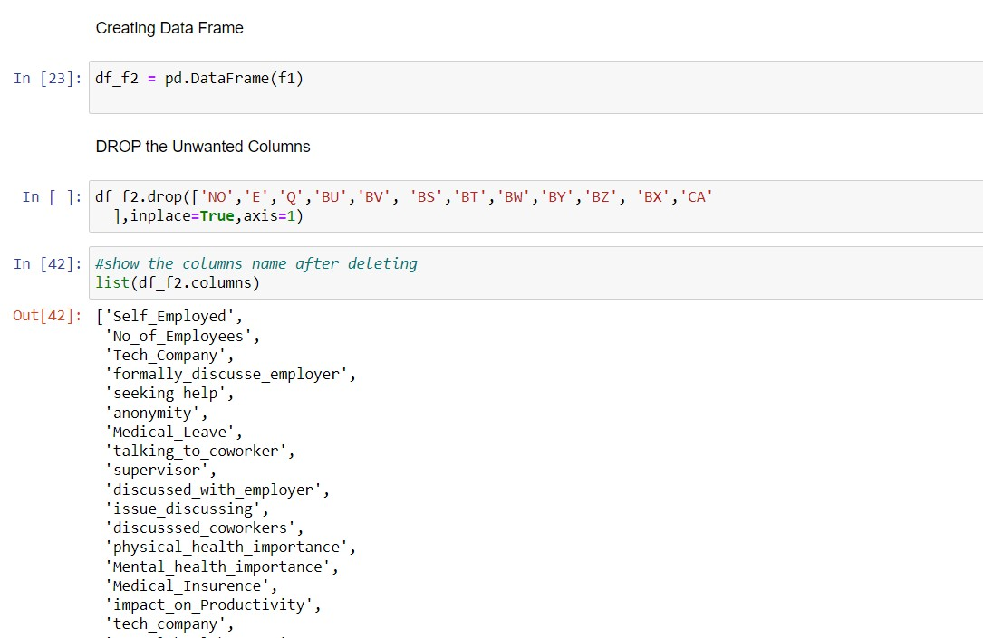
Clean Dataset
Data Cleaning

Slide 8
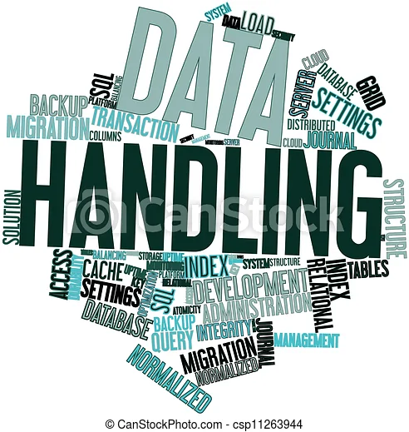
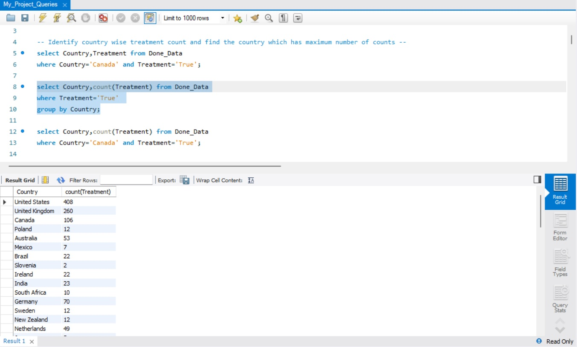
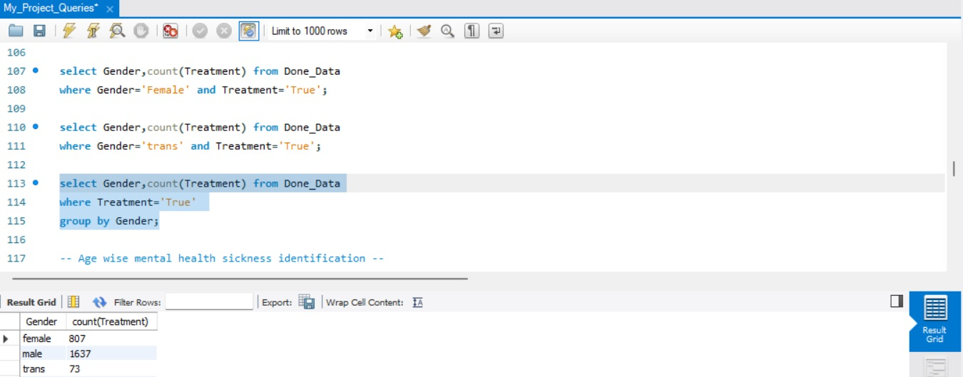
Data Handling
Data Handling is the process of gathering, recording, and presenting information in a way that is helpful to analyze, make predictions and choices.
MySQL Queries

Slide 9
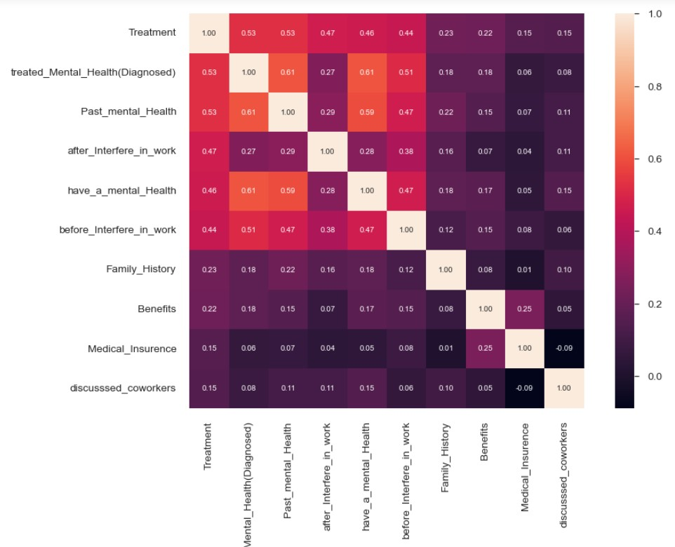
Data Exploratory Analysis
Exploratory Data Analysis (EDA) is an approach to analyze the data using visual techniques. It is used to discover trends, patterns, or to check assumptions with the help of statistical summary and graphical representations.
Also, in EDA we use following various python libraries to show our data in visual modes and convert it into encoded format.
Use Numpy and Pandas for linear algebra
Use Matplotlib and Seaborn for Visualization
Correlation Matrix

Slide 10

Machine Learning Algorithms
Logistic Regression:
Logistic regression is a classification algorithm used to assign observations to a discrete set of classes. Some of the examples of classification problems are Email spam or not spam, Online transactions Fraud or not Fraud, Tumor Malignant or Benign. And we use this for data surety.
K-Nearest Neighbour:
The abbreviation KNN stands for “K-Nearest Neighbour”. It is a supervised machine learning algorithm.
K nearest neighbors is a simple algorithm that stores all available cases and classifies new cases based on a similarity measure.
Random Forest:
A random forest is a machine learning technique that's used to solve regression and classification problems.
It utilizes ensemble learning, which is a technique that combines many classifiers to provide solutions to complex problems. A random forest algorithm consists of many decision trees

Slide 11

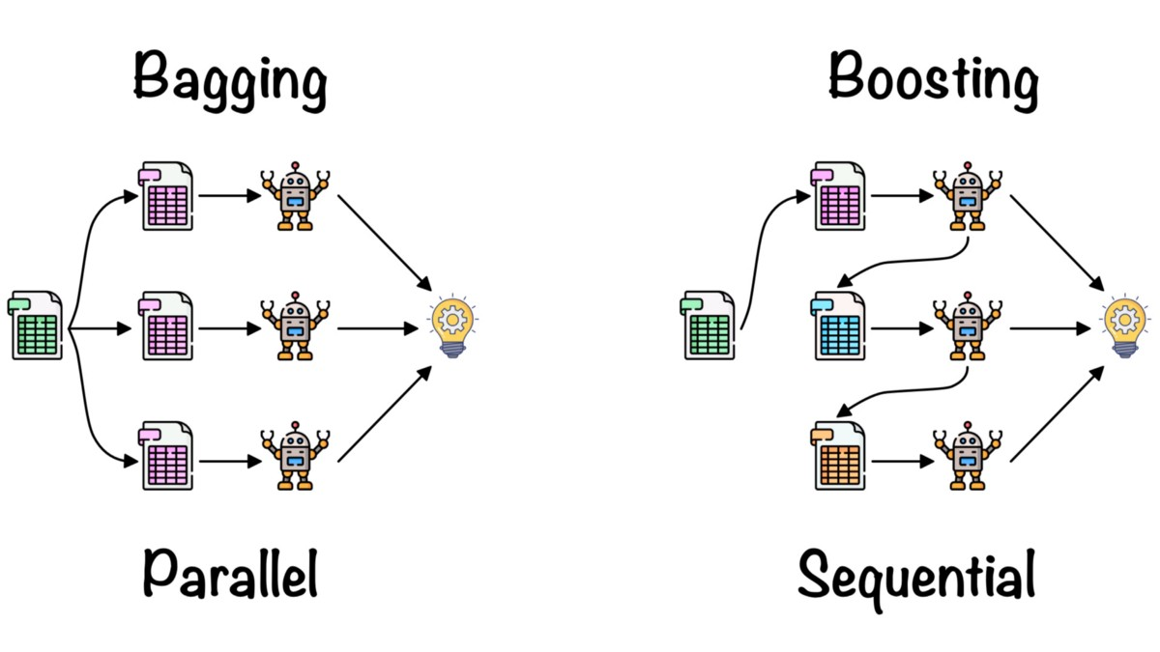
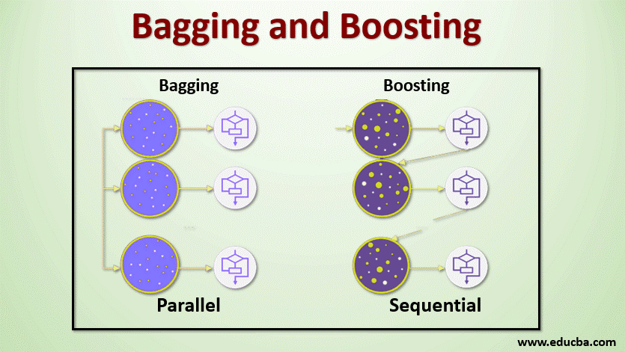
Bagging:
Bagging, also known as Bootstrap aggregating, is an ensemble learning technique that helps to improve the performance and accuracy of machine learning algorithms. It is used to deal with bias-variance trade-offs and reduces the variance of a prediction model. Bagging avoids overfitting of data and is used for both regression and classification models, specifically for decision tree algorithms.
Boosting:
Is a method used in machine learning to reduce errors in predictive data analysis. Data scientists train machine learning software, called machine learning models, on labeled data to make guesses about unlabeled data. A single machine learning model might make prediction errors depending on the accuracy of the training dataset.

Slide 12
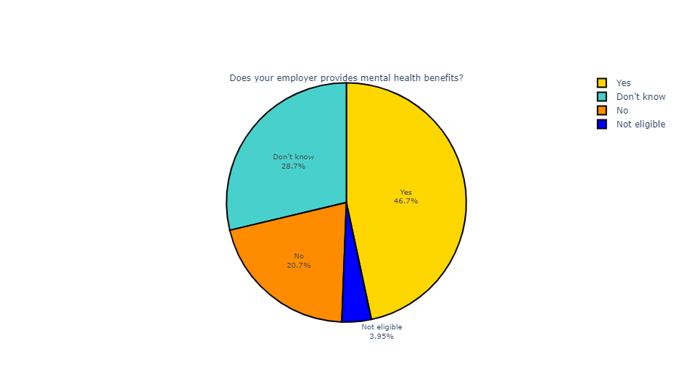
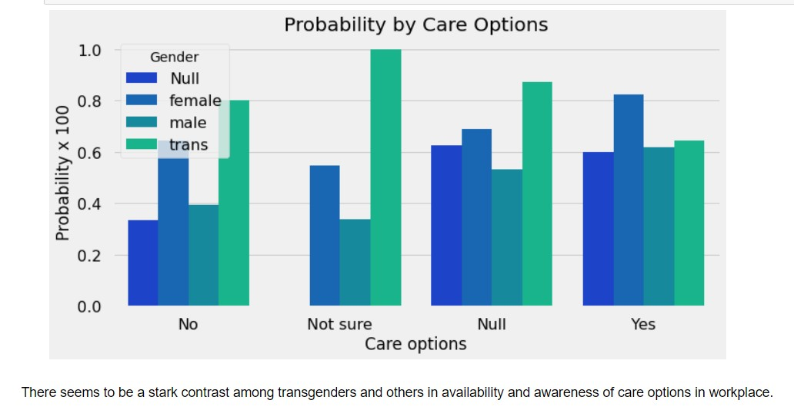
Data Visualization
Data visualization tools and technologies are essential to analyzing massive amounts of information and making data-driven decisions. The concept of using pictures is to understand data that has been used for centuries.
Pie Chart of Employee Benefit in Workplace
Bar Graph Represent Medical Care option

Slide 13
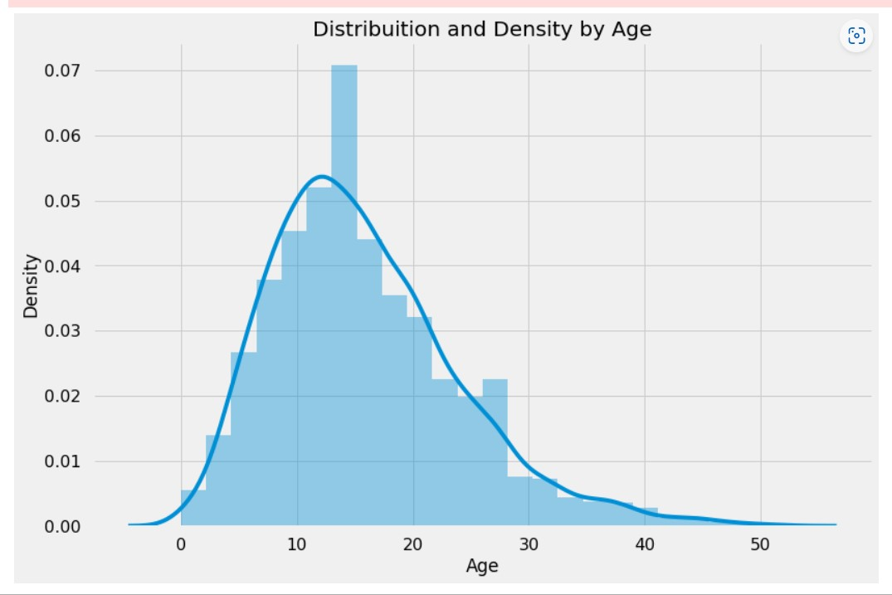
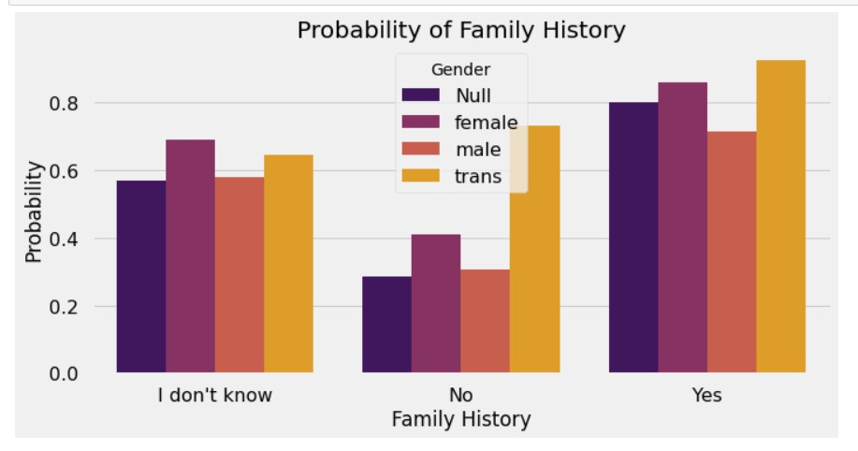
Histogram Representations of Higher Treatment Taken
Family History suffering from Mental Health

Slide 14
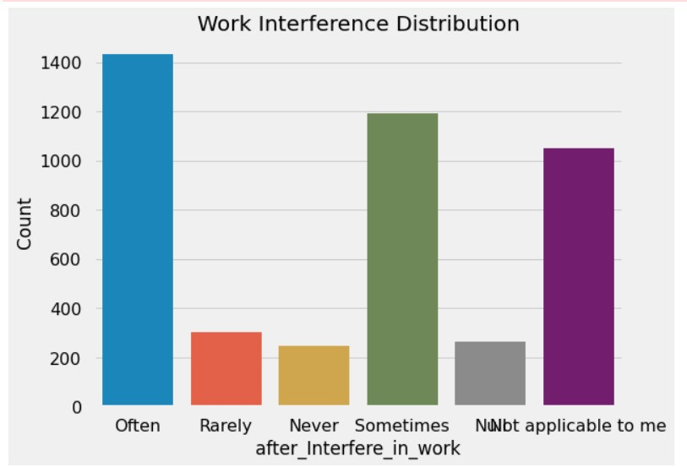
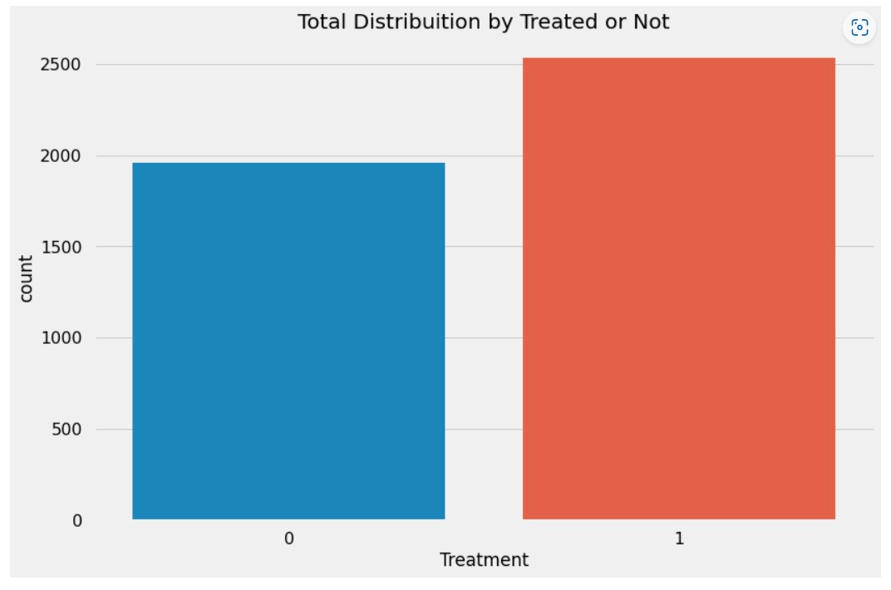
Bar Graph Representation of Work Place Affect
Treatment (Target Variable)

Slide 15
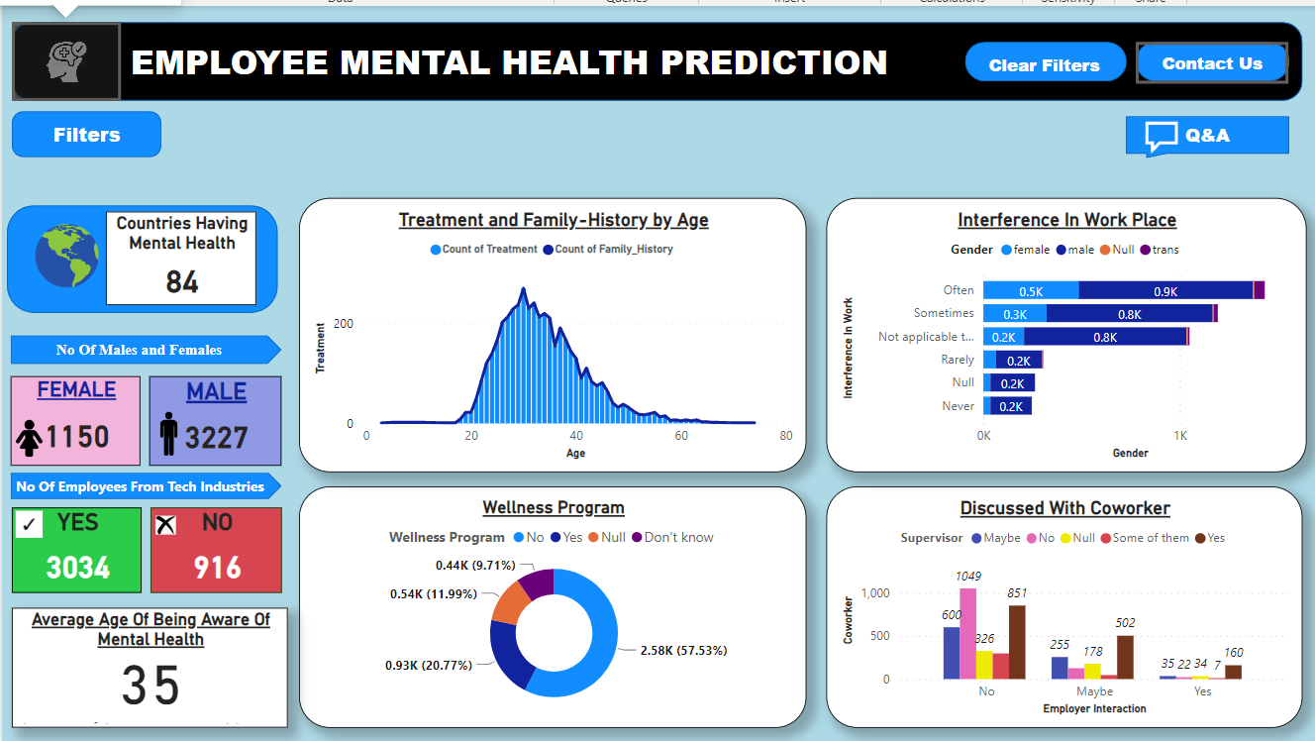
PowerBI Dashboard

Slide 16
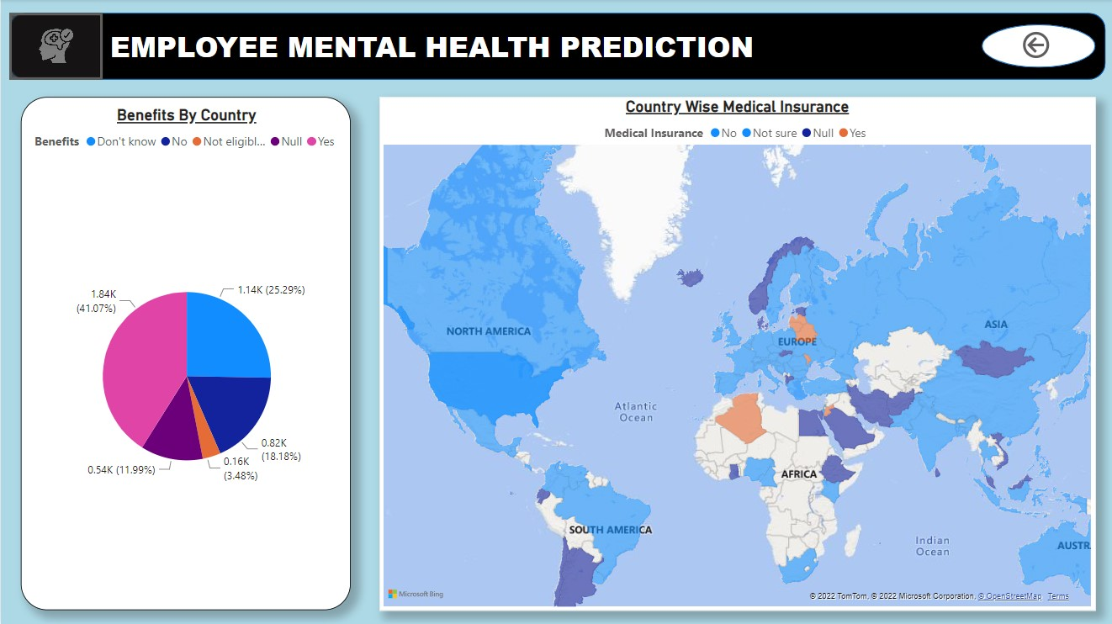

Slide 17


Conclusion and Future Scope
The analysis is done in the project that although mental health issues are on the rise due to increased stress in the industry. Still, employers are far behind in creating a workplace environment that is suitable for the employees facing these issues.
As the world is moving at a boost speed towards technology human is not aware of his health issues and firstly mental health was not an issue , but the progress in the field of technology led to increase the number of patients related to mental health.
Programmes should be carried out in each field not only in the technical industry but in each field , different types of awareness programmes should be carried out and each one should participate in such programmes and be aware of ours mental health issue.
National Alliance on Mental Illness (NAMI)
NAMI Family-to-Family education program.
NAMI Basics education program.
NAMI Peer-to-Peer education and support programs.
NAMI On Campus clubs for students.
NAMI Connection Recovery Support Group for individuals living with mental health problems.

Slide 18
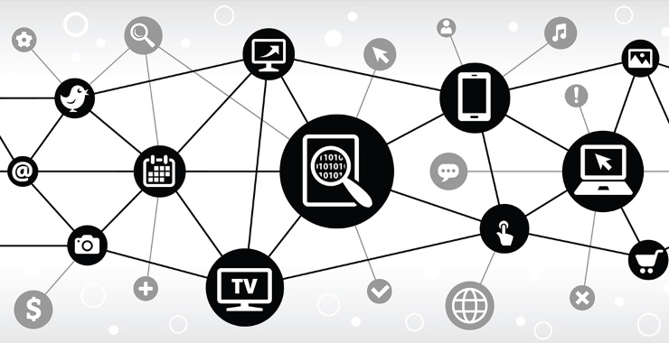

References
Sharon Leighton and Nisha Dogra. Defining mental health and mental illness Vol 01, Jan-2009.
Mental Health Continuum. Beyond blue. Website: https://beyou.edu.au/resources/mental-health-continuum. Accessed September 1, 2020.
National Institute of Mental Health. Any mental illness https:www.nimh.nih.gov/health/statistics/mental-illness.shtml#part_154785 Accessed September 1, 2020.
World Health Organization. Promoting mental health: concepts, emerging evidence, practice (Summary Report) Geneva: World Health Organization; 2004.
Websites (Data References):
https://www.kaggle.com/datasets/osmi/mental-health-in-tech-survey
https://osmhhelp.org/research

Slide 19


